Slide 1

Modelling the impact of vaccination, mask policies and mobility on the COVID-19 pandemic in Singapore
CSE 8803 Project Presentation
Zishu Liu Yuxin Xie Jichuan Zhang

Slide 2

CONTENT
Part 01
Introduction
Part 02
ODE Model
Part 03
Agent-based Model
Reference

Slide 3
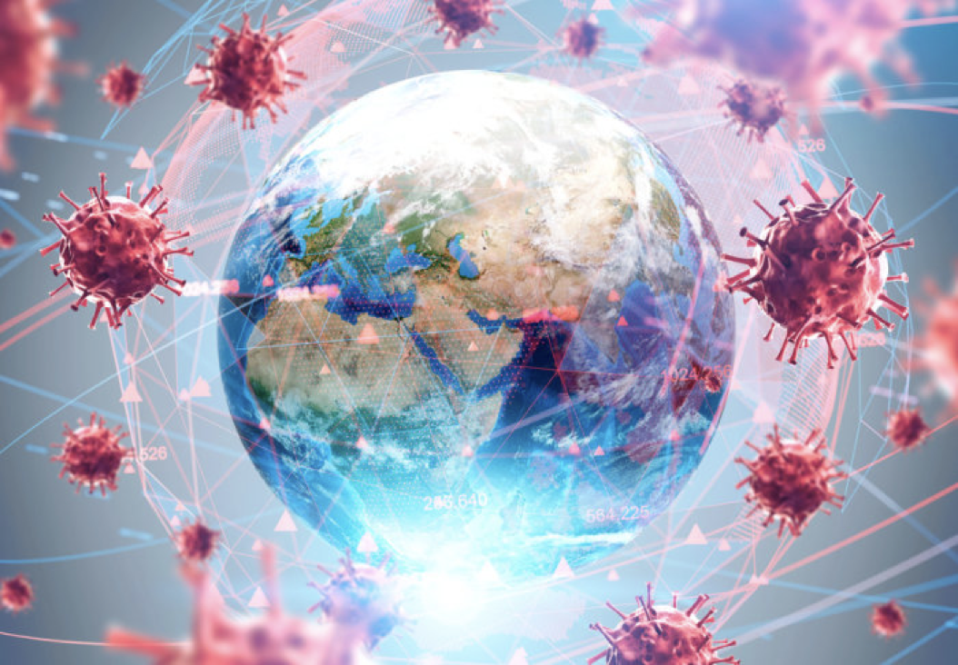
Part 01
Introduction

Slide 4



Part 01
Vaccination, mask policies
and mobility
Introduction
The outbreak of a new crown outbreak depends on many factors, among which human influences include population mobility pat- terns, mask prevalence, and vaccination rates.

Slide 5
Part 01
Introduction
Singapore outbreaks
More effective prevention strategies to achieve successful protests
Verify whether our research model is reasonable through data to achieve the purpose of accurately predicting the future trend of the epidemic.
First outbreak
No available vaccines
Very strict policies
Second outbreak
90% fully vaccinated
Relatively loose policies

Slide 6
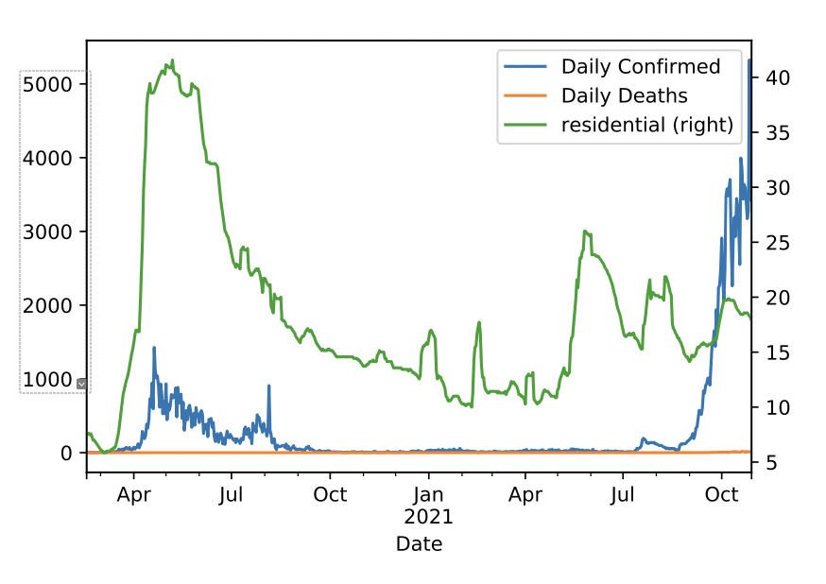
Part 01
Introduction
Data source
COVID-19 cases/deaths/vaccines: comes from data.world
Epidemiology & Demographics: built in covasim
Mobility: We use Google Community Mobility Reports as the indicator of mobility.
Policy: We use mask policy indicator, which is categorized into five categories

Slide 7
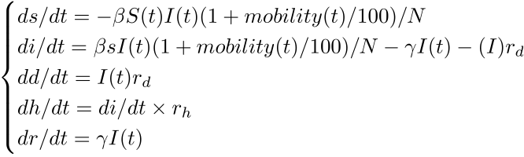
Part 02
ODE Model

Slide 8
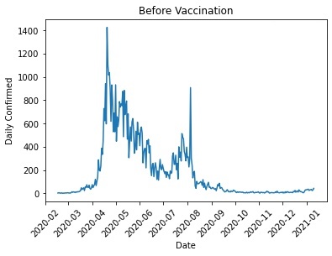
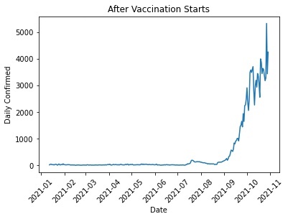
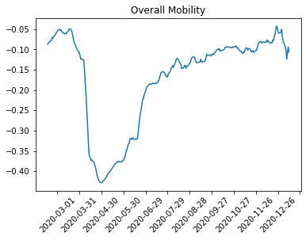
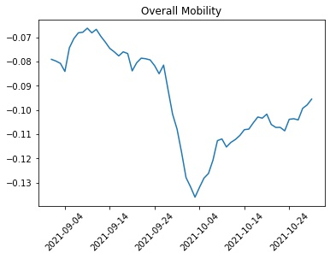
Part 02
Background &
Domain Research
ODE Model
Two outbreaks
Before vaccination: May 2020
After vaccination: September 2021
Need to integrate the influence of policy into ODE model.

Slide 9
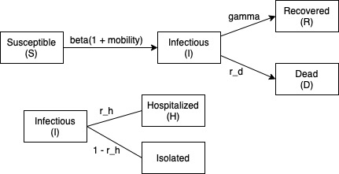
Part 02
ODE Model
Model description
ODE equations
Flow diagram of this SIR model
Input Data
S = Population - I - R
I = Intensive Care Unit (ICU) + General Wards + In Isolation
R = Cumulative Confirmed - Cumulative Death - I

Slide 10
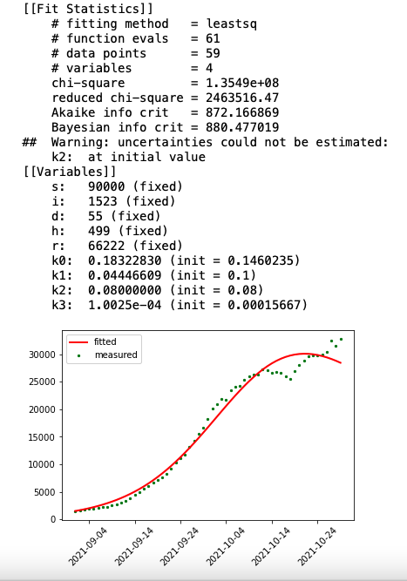
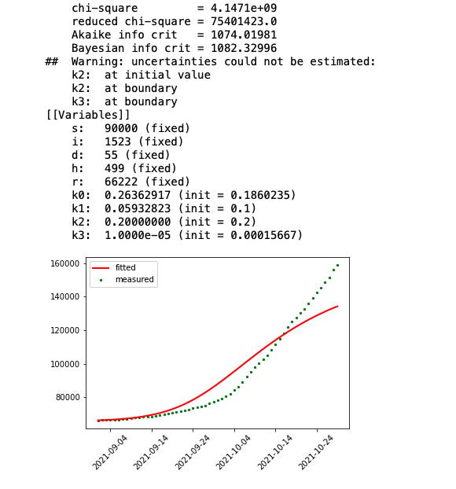
Part 02
ODE Model
Data fitting
Initial attempt (X)
MaxiR = Cumulative Confirmed - Cumulative Death - I
Using an iterative way to fitting multiple curves
Manually set the initial value of S state

Slide 11
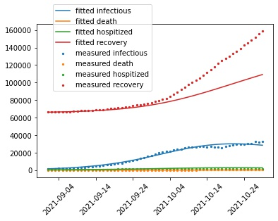
Part 02
ODE Model
Conclusion
Beta
Before Vaccination: 0.44964359
After Vaccination:0.18322830
Things need to be improved
Not fitting every curve as well
Value of S can’t reflect the fact

Slide 12

Part 03
Agent-based Model

Slide 13
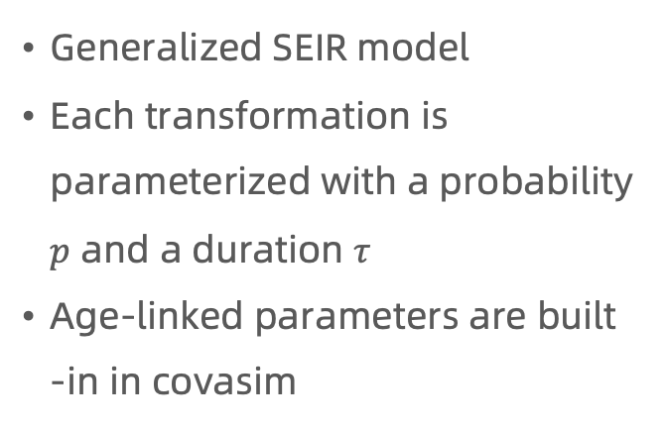
Part 03
Agent-based Model
Disease progression
Generalized SEIR model
Each transformation is parameterized with a probability $p$ and a duration $τ$
Age-linked parameters are built -in in covasim

Slide 14
Part 03
Agent-based Model
Contact network
Four contact networks:
Household
School
Work place
Community

Slide 15
Part 03
Agent-based Model
Agent states
Agents in different states have different beta values

Slide 16
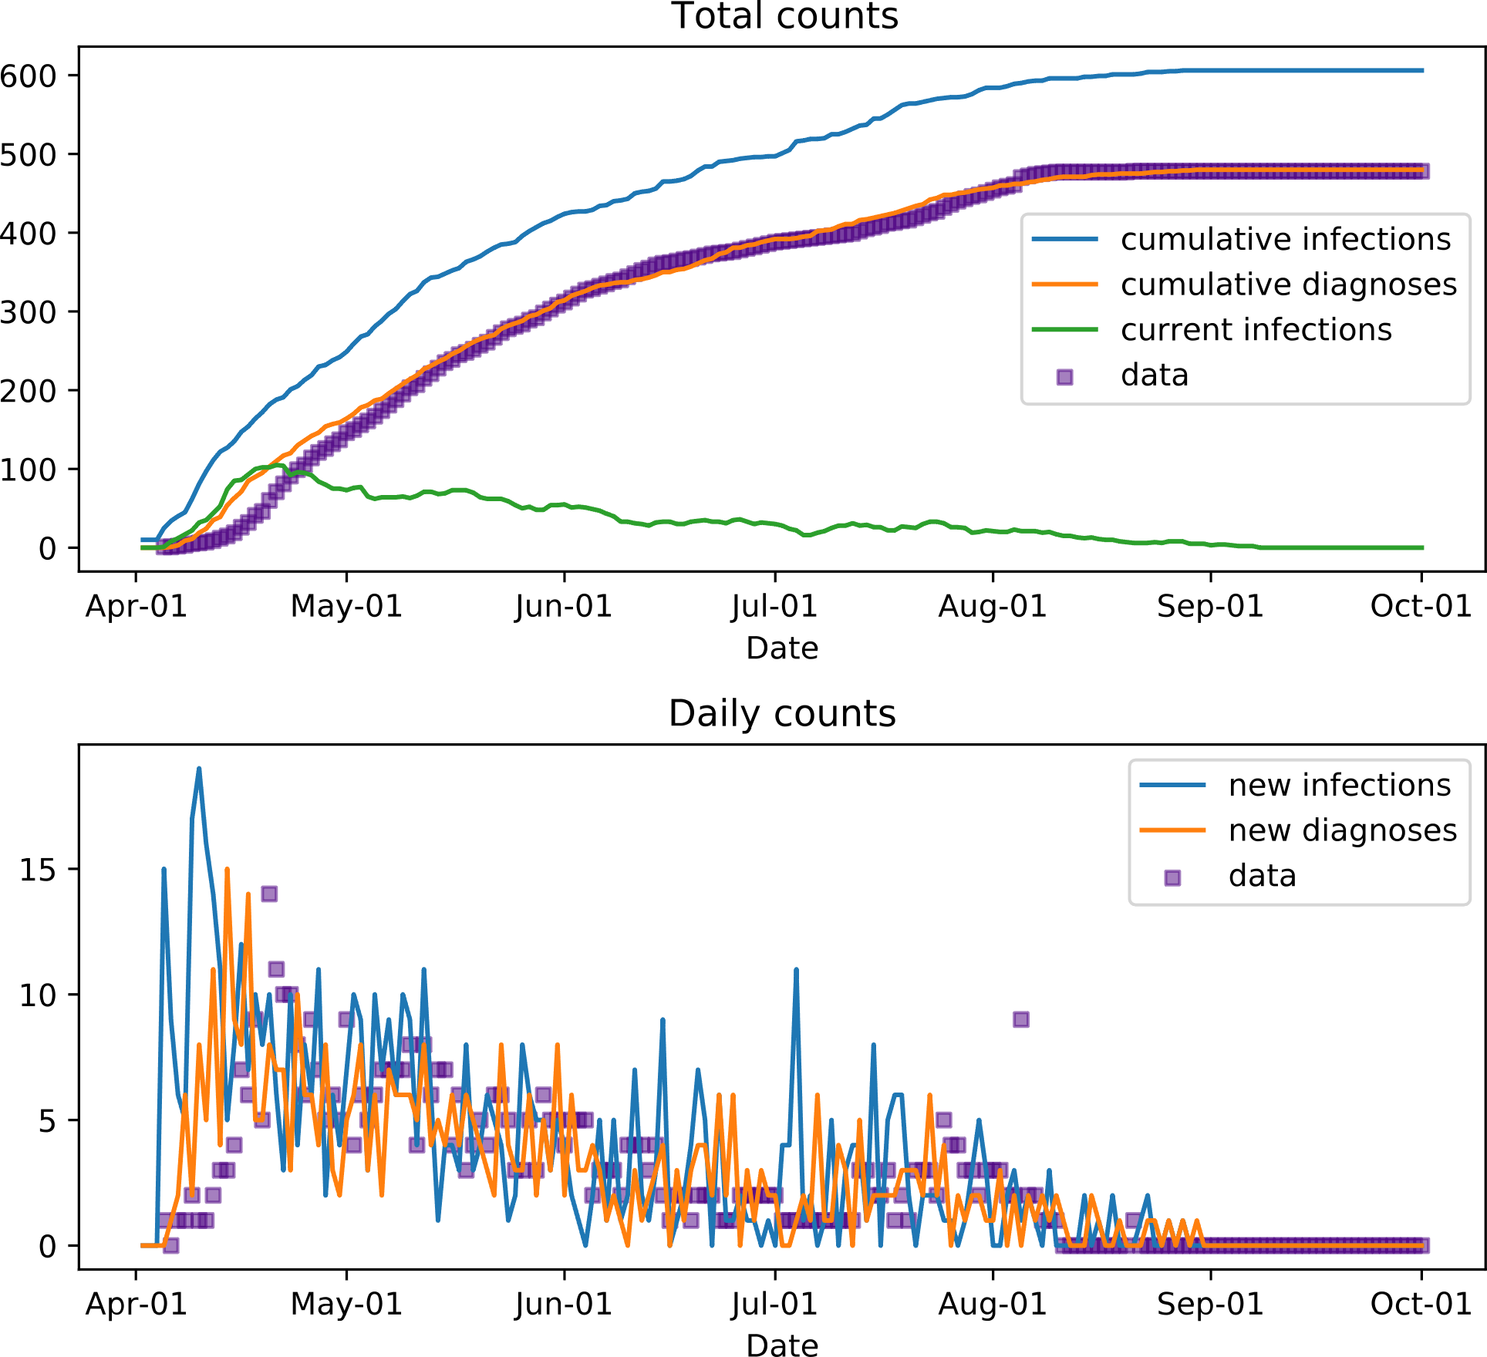
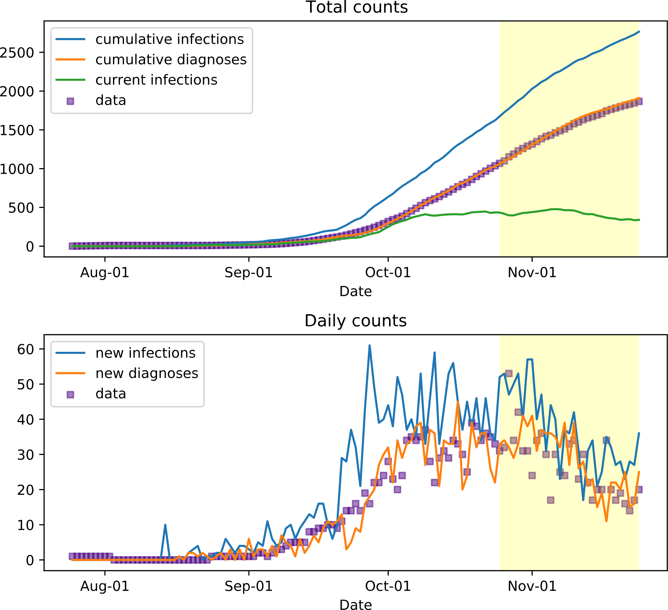
Part 03
Agent-based Model
Calibration results
First outbreak
Second outbreak

Slide 17
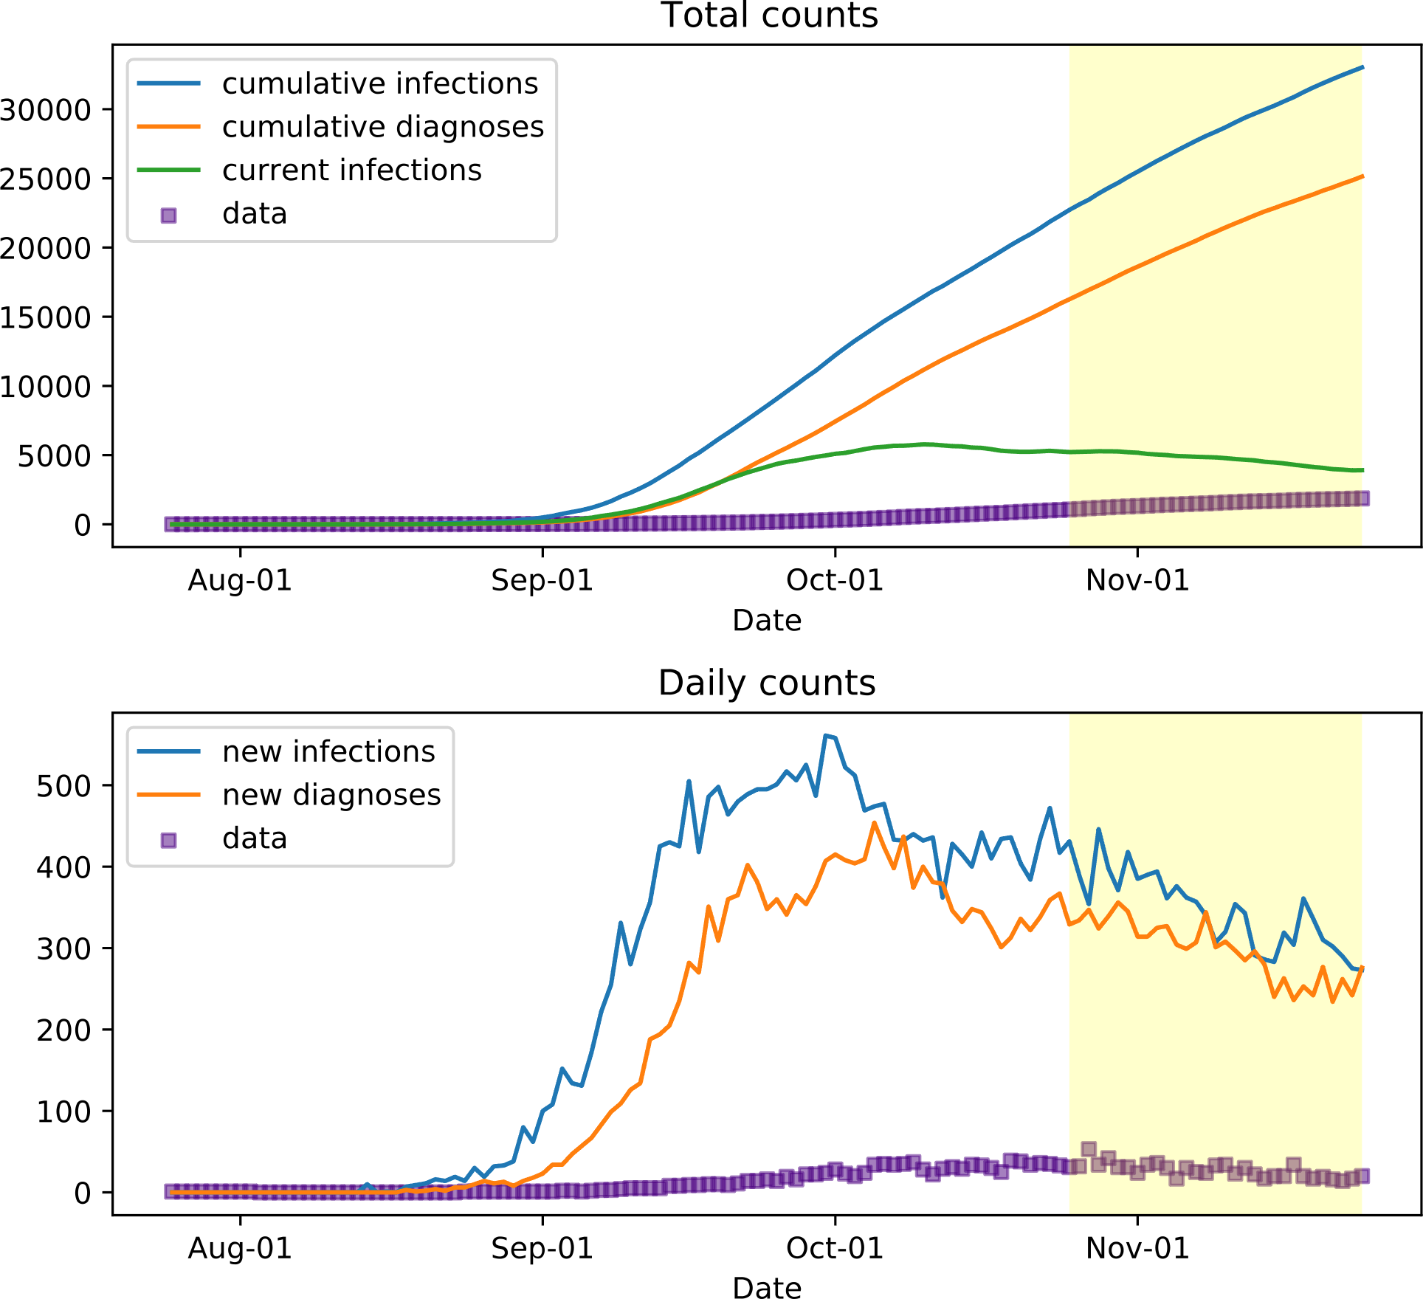
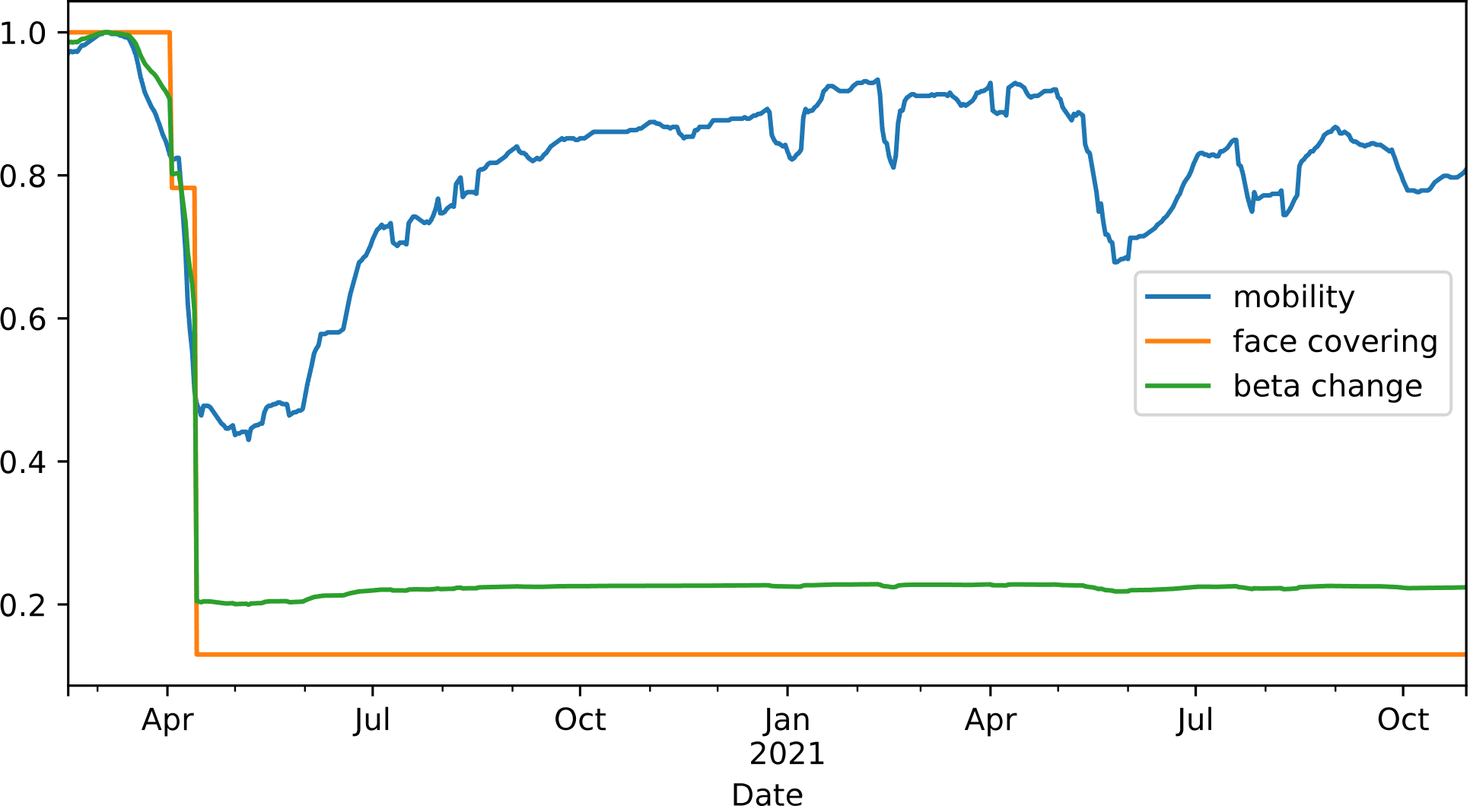
Part 03
Agent-based Model
Calibration results
Second outbreak without vaccination
Impact of mobility and policies

Slide 18

Thanks for Listening
-2021/12/07-
Zishu Liu Yuxin Xie Jichuan Zhang

Slide 19
Reference
Sheryl L Chang, Nathan Harding, Cameron Zachreson, Oliver M Cliff, and Mikhail Prokopenko. 2020. Modelling transmission and control of the COVID-19 pandemic in Australia. Nature communications 11, 1 (2020), 1–13.
Erik Cuevas. 2020. An agent-based model to evaluate the COVID-19 transmission risks in facilities. Computers in biology and medicine 121 (2020), 103827.
De Kai, Guy-Philippe Goldstein, Alexey Morgunov, Vishal Nangalia, and Anna Rotkirch. 2020. Universal masking is urgent in the COVID-19 pandemic: SEIR and agent based models, empirical validation, policy recommendations. arXiv preprint arXiv:2004.13553 (2020).
Cliff C Kerr, Robyn M Stuart, Dina Mistry, Romesh G Abeysuriya, Katherine Rosenfeld, Gregory R Hart, Rafael C Núñez, Jamie A Cohen, Prashanth Selvaraj, Brittany Hagedorn, et al. 2021. Covasim: an agent-based model of COVID-19 dynamics and interventions. PLOS Computational Biology 17, 7 (2021), e1009149.
David S Khoury, Deborah Cromer, Arnold Reynaldi, Timothy E Schlub, Adam K Wheatley, Jennifer A Juno, Kanta Subbarao, Stephen J Kent, James A Triccas, and Miles P Davenport. 2021. What level of neutralising antibody protects from COVID-19?. medRxiv (2021).
Petra Mlcochova, Steven A Kemp, Mahesh Shanker Dhar, Guido Papa, Bo Meng, Isabella ATM Ferreira, Rawlings Datir, Dami A Collier, Anna Albecka, Sujeet Singh, et al. 2021. SARS-CoV-2 B. 1.617. 2 Delta variant replication and immune evasion. Nature (2021), 1–6.
Petrônio CL Silva, Paulo VC Batista, Hélder S Lima, Marcos A Alves, Frederico G Guimarães, and Rodrigo CP Silva. 2020. COVID-ABS: An agent-based model of COVID-19 epidemic to simulate health and economic effects of social distancing interventions. Chaos, Solitons & Fractals 139 (2020), 110088.

